Slide 1
Cab Booking System
By-
Arundhati Dutta (14400113009)
Pallavi Sharma (14400113019)
Sayan Basu (14400113032)
Soumeet basak (14400113035)

Slide 2

Introduction
Cab Booking System is an e-commerce venture that has the potentiality to generate huge revenue.
Aim of the project is to develop a system that will increase efficiency and reduce the time and hassle of customers trying to book cabs to their destinations.

Slide 3
Objective
Giving different choices for method of payment and allowing a hassle free, computer generated payment.
Updating the customer with all the knowledge like driver details, cost per km.
The system lets the driver know the location so that pickups can be easily arranged.
System brings simplicity to both drivers and customers as customers can choose to book.

Slide 4





Technologies
HTML5 and CSS with Bootstrap framework
Javascript with jQuery and AJAX libraries.
Python 3.4 as Server-end scripting language
Oracle 11G as database-engine

Slide 5
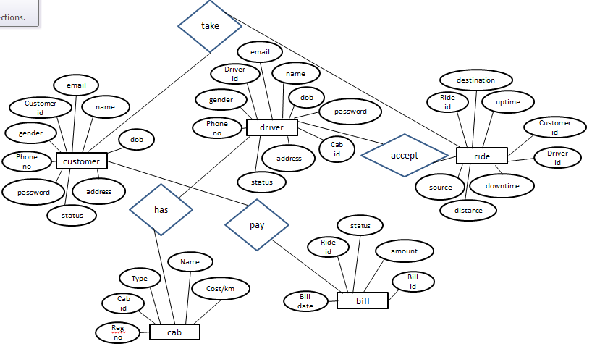
Entity Relationship Diagram

Slide 6
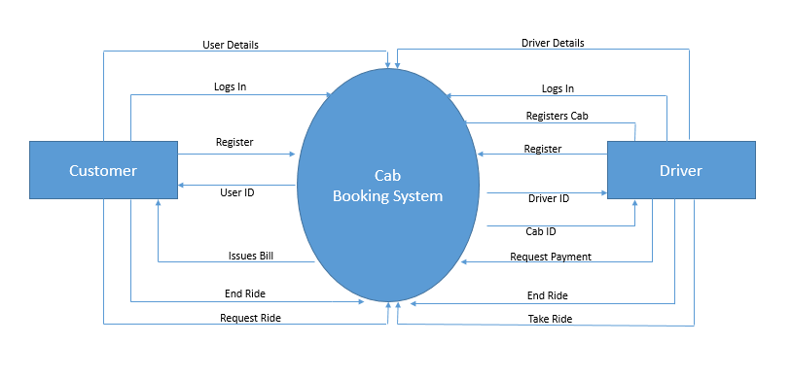
dataflow diagram
level-0 contextual diagram

Slide 7
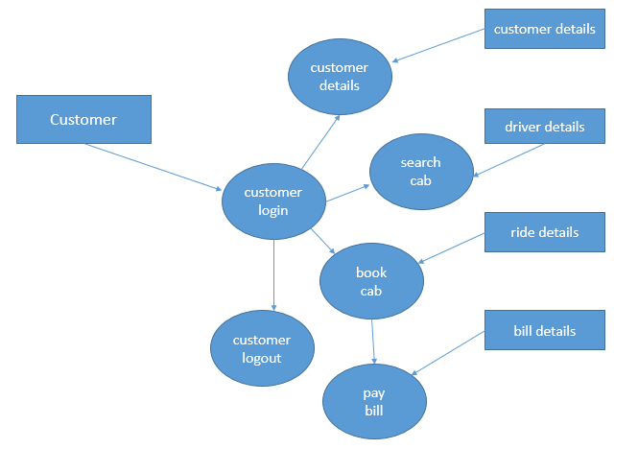
level-1 customer aspect

Slide 8
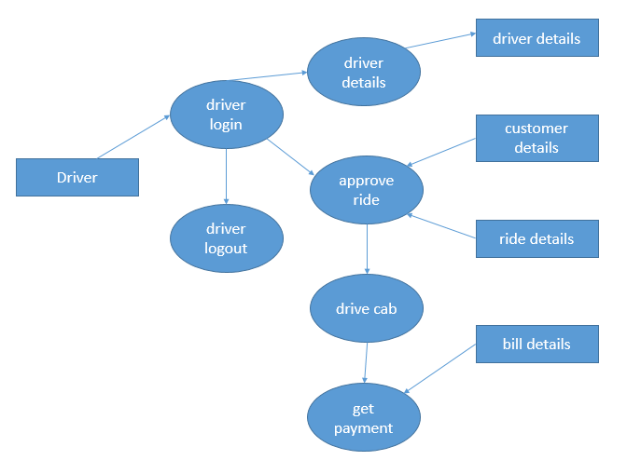
level-1 driver aspect

Slide 9
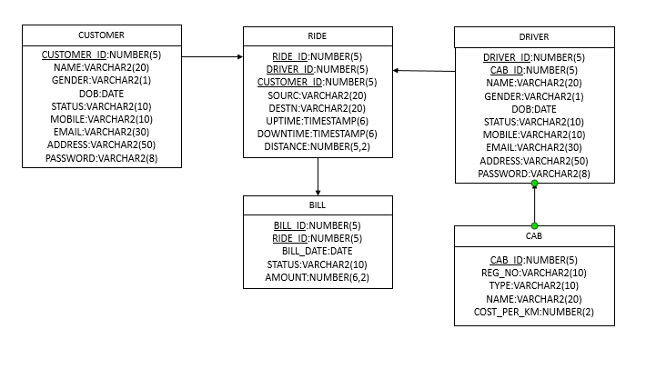
Database schema

Slide 10
Future Scope
Mobile web-friendly. Our websites are optimized for display on smartphones and tablets so that your customers can book on the go from their portable devices.
Secure Credit Card Processing and Storing. With industry-standard encryption, your customers can rest assured that their payments will always remain secure with our SSL connection. We also offer the convenience of saving your customers' payment information in our secure vault to speed up repeat bookings.
Booking Zones. You can select cabs from a range of cabs according to the fare/km in that area. You can also apply free or discount coupons on the bookings if available.
SMS (text message) ,Call and Email notifications. The customer can be kept updated about the cab’s arrival time via the notification system. After the ride the customer receives a receipt of the ride via SMS or email.

